Slide 1
TLS® Weight Loss Solution
OVERVIEW
TLS – Transitions Lifestyle System
Notes:
What is different this time?
Are you committed to staying the course?
Do you have a plan to stay committed

Slide 2
Department of Health Statistics (HK)
Prevalence of Selected Lifestyle Practices and Health Status Among Persons Aged between 18 – 64
Lifestyle Practices & Health Status | Percentage Male | Percentage Female | Both Sexes
Inadequate physical activity (by WHO recommendations) | 56.3% | 68.0% | 62.5%
Inadequate daily fruit and vegetable intake (<5 servings/day) | 85.9% | 76.6% | 81.0%
Overweight and obesity (BMI > 23.0) | 49.6% | 29.5% | 39.0%

Slide 3
Healthy Weight Healthy Kids
In Hong Kong, 20% among primary school students are overweight in 2013/14
Every aspect of the environment in which children are conceived, born and raised can contribute to their risk of becoming overweight or obese
Obese children have more metabolic risk factors and at increased risk of diabetes, fatty liver disease, sleep apnea, asthma and musculoskeletal disorders
Department of Health
http://www.chp.gov.hk/files/pdf/ncd_watch_mar2015.pdf

Slide 4
What goes wrong with weight loss?
Diets don’t work
Lose water & muscle – not fat
All calories aren’t created equal
Neurological changes from calorie depletion
Hormonal changes
Metabolic changes

Slide 5
DIET PROGRAMS
Often put an emphasis on WHAT to eat, and don’t teach HOW to eat
Focus on the scale and not true fat loss
Don’t support hormones and metabolic changes

Slide 6
DIET PROGRAMS
Don’t offer multiple programs since not everyone is at the same commitment level
Don’t have trained coaches

Slide 7
WHY
DO YOU WANT TO
LOSE WEIGHT
Get healthy?
Live longer?
Reduce risk of disease?
Have children or have energy to play with them?
Want to look fabulous?

Slide 8
Lack
of exercise
Family eats
unhealthy
WHAT
are your
OBSTACLES
Food
prep or
cooking time
Work or
work
functions
Long
days
Alcohol

Slide 9
WHAT IF...
there was a program that was comprehensive, customizable, backed by science and focused on a lifestyle approach – and had proven success in improving your health and look?

Slide 10
The most comprehensive & customizable program available
A true lifestyle program
Focus on fat loss & keeping it off

Slide 11
4
Components
Low-glycemic Impact Eating
Improved Body Composition
Supplementation
Education
Weight loss isn’t magic; It’s science & these 4 components are what is leading the way!

Slide 12
Low Glycemic Impact Eating
Health Benefits
Promotes Cardiovascular Health
Helps Maintain Blood Sugar Levels
Assists the Body to Burn Fat
Improves Energy
Low GI Foods are Naturally Anti-inflammatory
What is LOW GLYCEMIC IMPACT eating?
Notes:
Low GI eating is the quality of the food (glycemic index plus the quantity of the food (glycemic load)

Slide 13
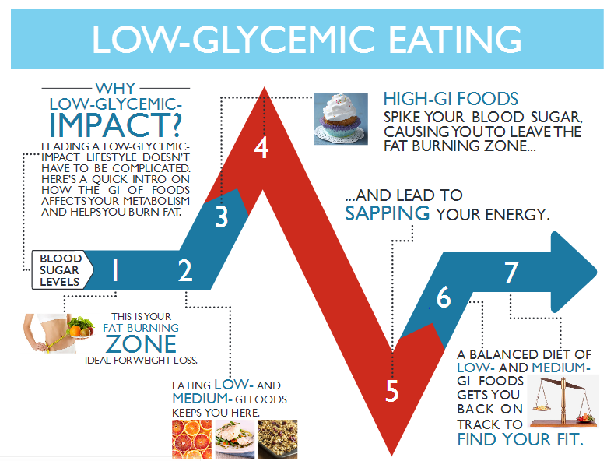
1. Low Glycemic Impact Eating
Notes:
When on this slide, please discuss the factors (fat, fiber, protein) that slow down the fast release of sugars. For example, we are NOT recommending to eat cake, but because cake has a high fat content, it is lower GI (just lacks nutrients). So, if they HAVE to have a cheat meal, it is best to pair that OCCASIONAL cheat with something to lower the release of blood sugar release. Alcohol is a great example too…never drink on an empty stomach

Slide 14
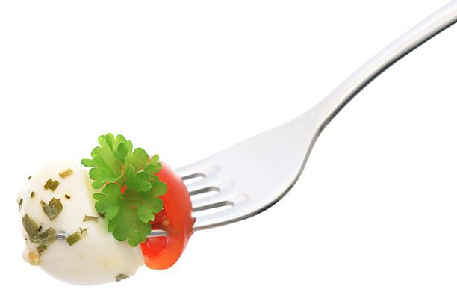
DON’T Restrict Food Groups
With the TLS® Program, you will never see a restriction of the major food groups necessary for overall health
Proteins
Carbohydrates
Fats
You will not have to starve yourself or give up flavor to succeed!

Slide 15
Body Composition
Transitioning from a Fat Storing Lifestyle to a Fat Burning Lifestyle
Fat Loss & Inches vs. Weight Loss
Skinny Fat
Notes:
With weight loss, you can easily lose muscle & water. Not drinking enough water can cause a pound/kg drop and not going to the bathroom to move your bowels can cause a pound/kg gain. True fat loss is about re-shaping your body. Seeing the changes in your inches and clothing..
Skinny fat – people who may look decent in clothing but are flabby and may be unhealthy.

Slide 16
Body Composition & Exercise
Takes you from a high body fat % to low
Changes your shape
Fit & look better in clothing
Take your measurements - (body fat and inches)
Fitness means FIT IT IN
Types of Exercise
Cardiovascular
Weight Resistance
Stretching/Flexibility
Notes:
HIIT High Intensity Interval Training – great for fat burning

Slide 17
Why TLS® Supplementation?
Designed to help while adopting a new healthy lifestyle.
Poor Dietary Habits
Unhealthy eating, yo-yo dieting, skipping meals
Hormones Not Balanced
Leptin, Ghrelin, Cortisol and other
Carbohydrate Sensitivity
Digestive discomfort
Can’t imagine a day without grains
Chronic Stress and Fatigue
Binge eating, visceral fat
Metabolism Support
Provide daily nutrients for normal metabolic support
Burn Fat
Promote thermogenesis and lipolysis

Slide 18
TLS® Supplementation
CORE
ACTS
Conjugated Linoleic Acid - (Tonalin CLA)
Thermochrome with Green Coffee Bean Extract
Trim Tea
Nutrition Shakes
Notes:
18

Slide 19
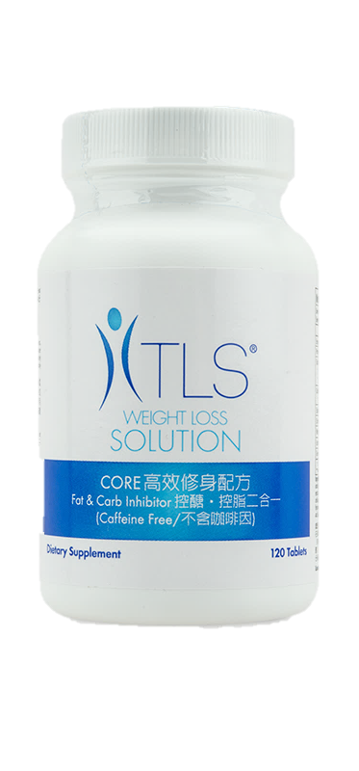
TLS® CORE Fat & Carb Inhibitor
Promotes reduction in body mass index (BMI)
Helps promote weight loss
Inhibits the amylase enzyme and slows the absorption of carbohydrates into the bloodstream
Helps inhibit carbohydrate absorption in the body
Helps promote the feeling of fullness

Slide 20
TLS® Adrenal Cortisol Thyroid Stress Support Formula (ACTS)
Helps the body to adapt to stress
Helps support better emotional responses to stress
Helps to minimize certain stress related issues
Weight gain
Difficulty with sleep patterns
Helps to support better mood changes
May help reduce occasional fatigue associated with stress
Supports mental clarity in times of stress

Slide 21
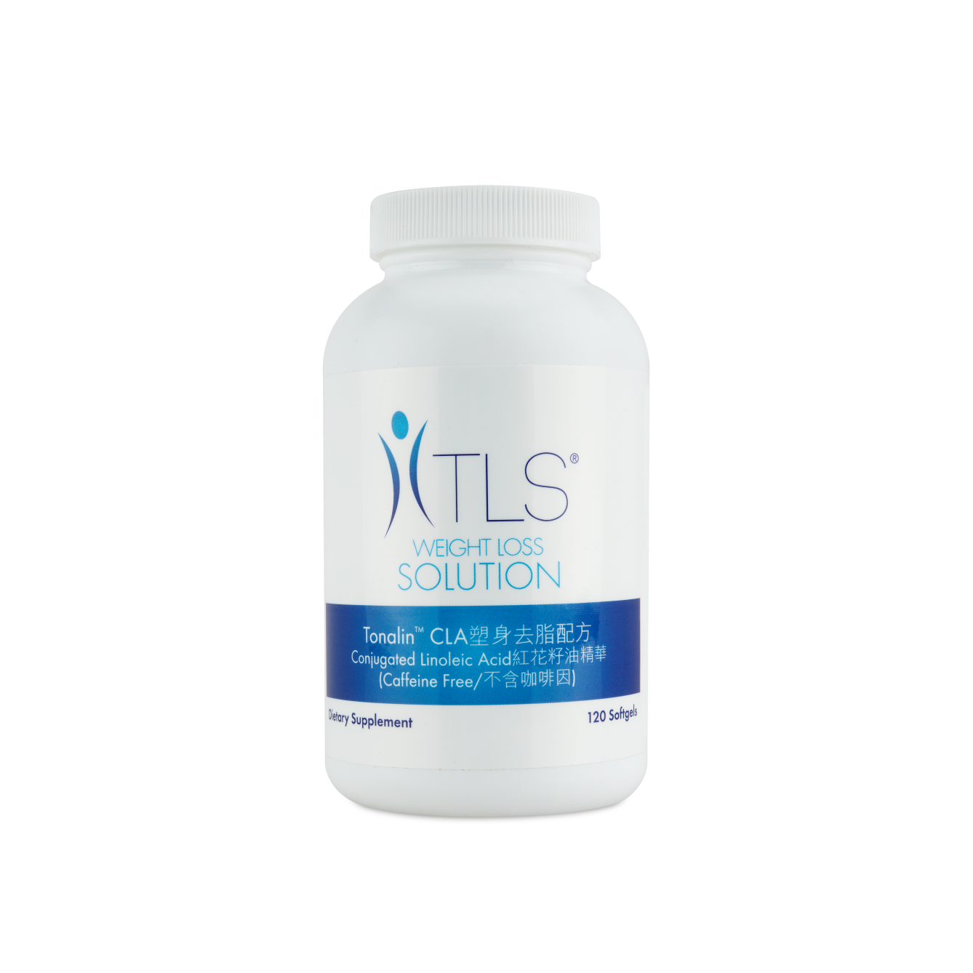
TLS® Tonalin™ CLA
Helps reduce overall body fat when used in combination with exercise
Assists in promoting lean muscle mass
Targets stubborn belly fat
May help to reduce the percentage of body fat while preserving muscle tissue
Promotes the utilization of body fat as fuel

Slide 22
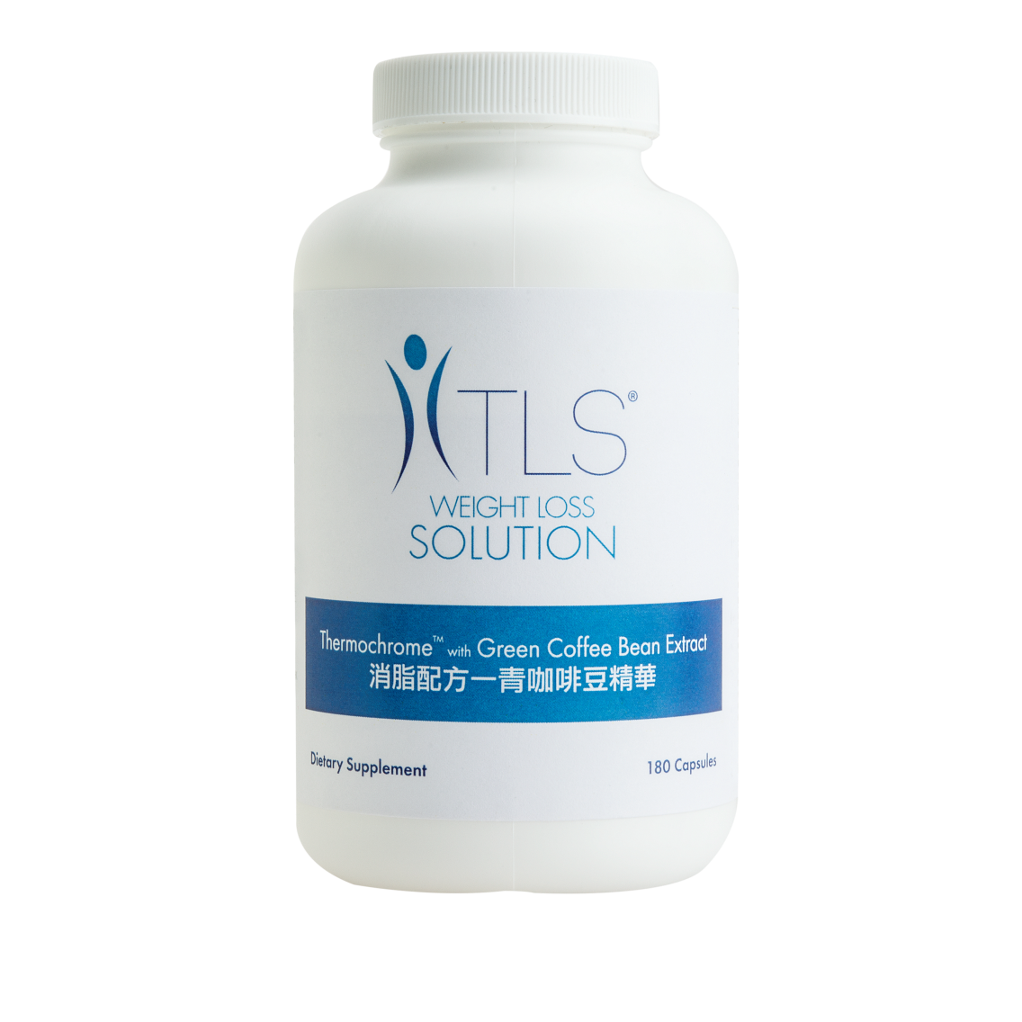
TLS® Thermochrome with Coffee Bean Extract
Supports healthy weight loss
Supports thermogenesis and lipolysis
May help increase energy
May help suppress appetite

Slide 23
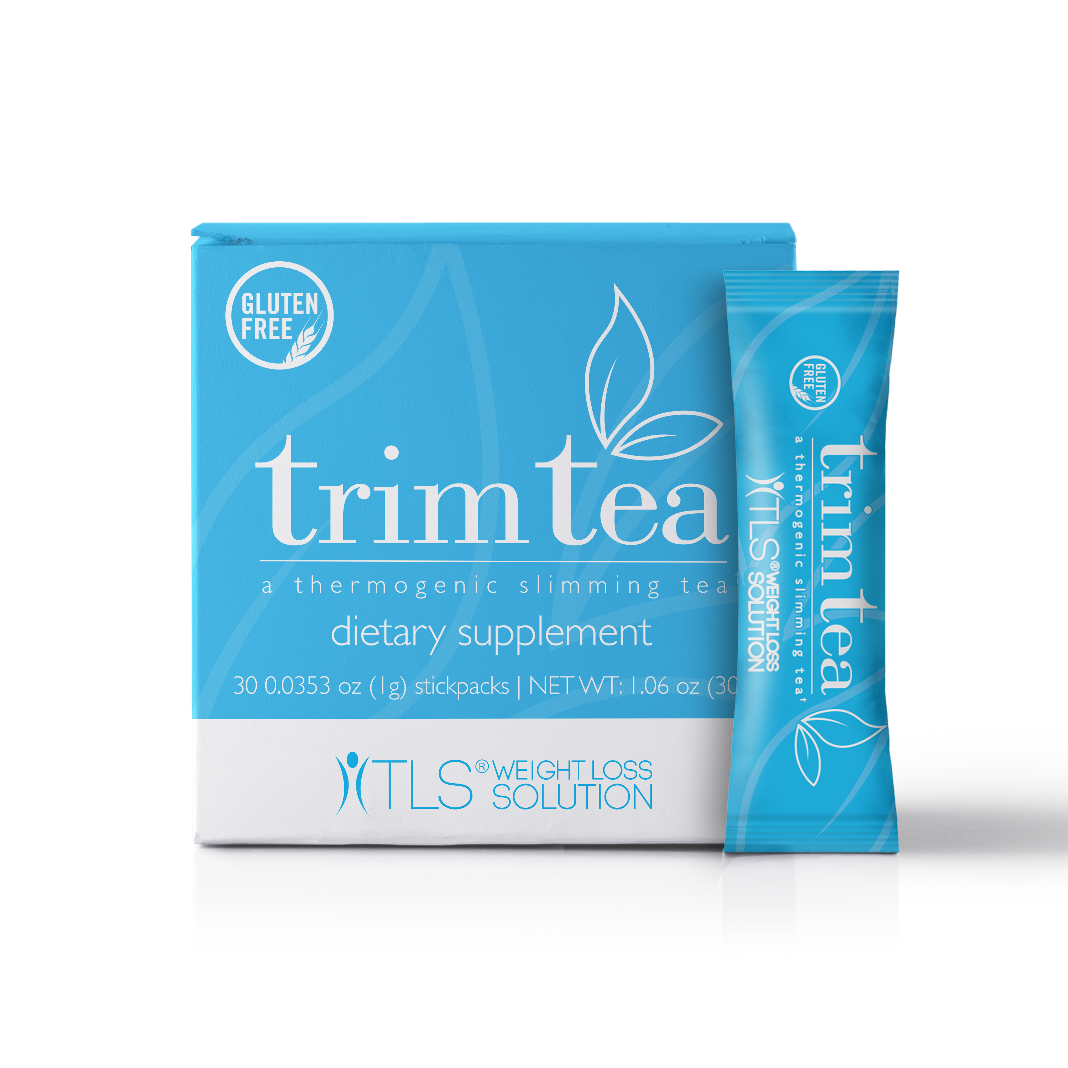
TLS® Trim Tea
Promotes healthy weight management
May assist in stabilizing blood sugar*
Supports cardiovascular health
Helps curb appetite
Supports metabolic balance & wellness
*This product is not registered under the Pharmacy and Poisons Ordinance or the Chinese Medicine Ordinance. Any claim made for it has not been subject to evaluation for such registration. This product is not intended to diagnose, treat or prevent any disease.

Slide 24
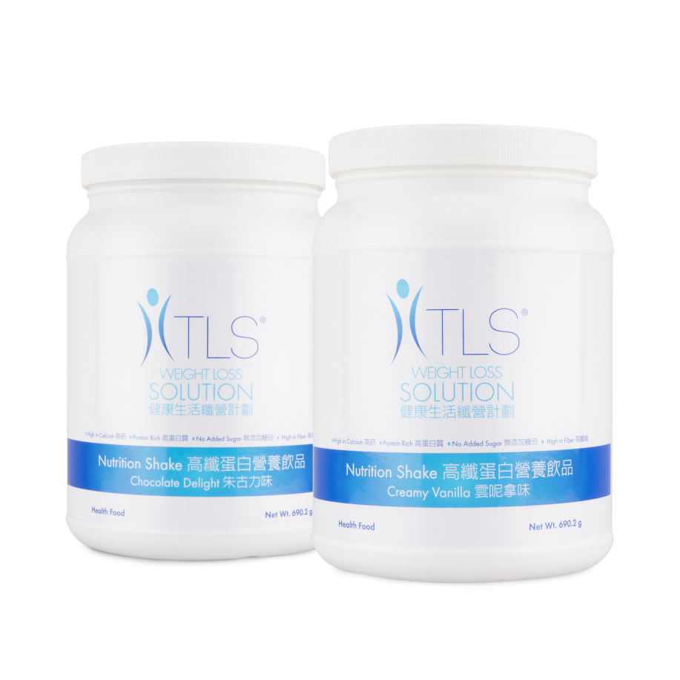
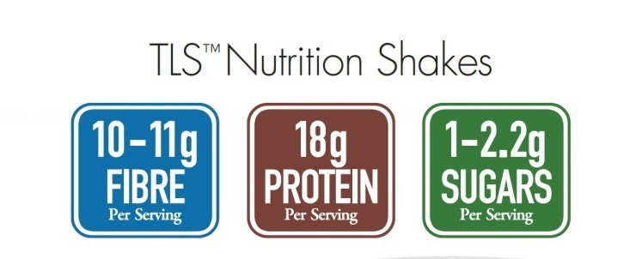
TLS® Nutrition Shake
TLS® Nutrition Shakes
10
2.3

Slide 25
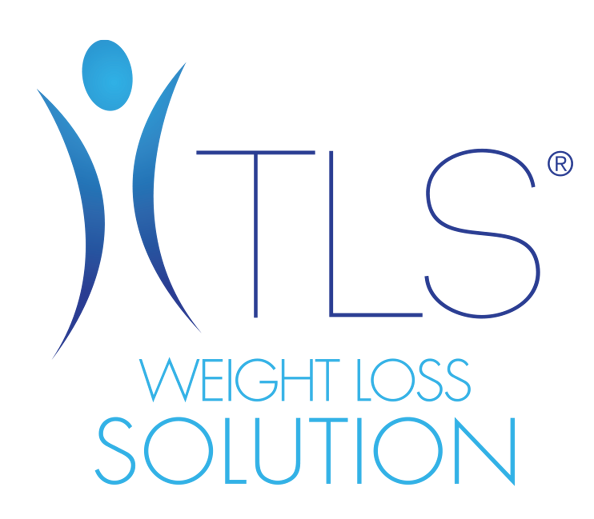
TLS® Education...
teaches you how to eat. Other programs tell you what to eat.
doesn’t restrict food groups.
teaches you how to eat for life, but realizes what’s right for someone else...may not always be right for you.
teaches you how to build your body the right way.

Slide 26
12 Weeks of Education
Goal Setting & Detox
Low Glycemic Impact
Reading Labels
Improving Metabolism
Exercise & Body Composition
Planning & Dining Out
Nutrition Basics
Creating Healthy Habits
Overcoming Obstacles
Managing Stress
Assessing Results
Living the TLS® Lifestyle
Supplement Regimens

Slide 27
Other Educational Topics
Gluten Sensitivity
Self Confidence
Food Addiction
Appetite Control
Remembering where you started & where you never want to go back to
Share your Story
Meal Planning & Grocery Shopping
Sweeteners
Hormones Health & Stress
Why Supplements Help
Alcohol
Sleep

Slide 28
TLS® Programs
Depending on your goals and your commitment level, your TLS Coach has many program, supplement and vitamin options and coaching available for you.
The Most Common Programs
12 Weeks - (Full Comprehensive Program)
8 Weeks
6 Weeks
4 Weeks
21 Days
7 Day Detox

Slide 29
7 Day Detox
Why it’s for you:
You’re looking for a kick-start to receive maximum benefits from your TLS® program.
What to expect:
Varies for each individual; purges the body of toxins, resulting in decreased energy for a couple of days followed by a surge of energy.
What you’ll do:
Follow a strict Low-Glycemic Plan
8-12 cups of vegetables
3 fruits
Two 3oz servings of protein
Two servings of good fat oils
No Grains, Dairy, Starches, alcohol, junk
8+ Cups water
No Exercise
Notes:
Go through plan and do’s & don’ts. Address detox is optional. Have all plans laminated

Slide 30
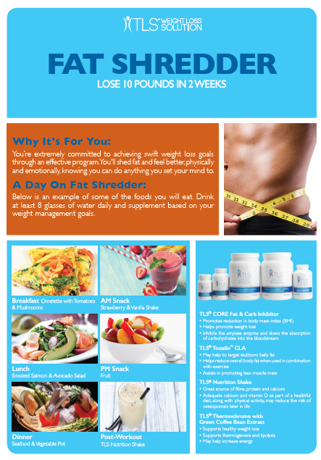
Fat Shredder
Why it’s for you:
For those who are extremely committed to achieving short-term weight loss goals, the Fat Shredder program is a high-intensity, two-week weight loss regimen. Through a focused food guide, a quick, but intense workout plan and use of TLS supplements, you’ll shred fat, add muscle and feel better, physically and emotionally, knowing you can do anything you set your mind to doing.
What to expect:
Lose up to 10 pounds during this two-week program.
What you’ll do:
Follow a strict meal plan with each day consisting of:
8-12 cups of vegetables
2 TLS Nutrition Shakes
3-4 servings of protein
2 servings of good fats
2 servings of fruit
Take TLS Supplements, as directed.
Notes:
Explain program details

Slide 31
Rapid Results
Why it’s for you:
You’re motivated, dedicated and committed to do what it takes to reach your weight loss goals. You’re ready to break unhealthy habits and start shedding fat and inches.
What to expect:
Lose 2-3 pounds per week.
What you’ll do:
Follow a strict low-glycemic menu plan, with each day consisting of:
5-6 servings of proteins
6-12 servings of vegetables
2 servings of dairy
No grains or starches
2 servings of good fats
2 servings of fruits
Exercise (4-5 days per week)
Take TLS Supplements, as directed.

Slide 32
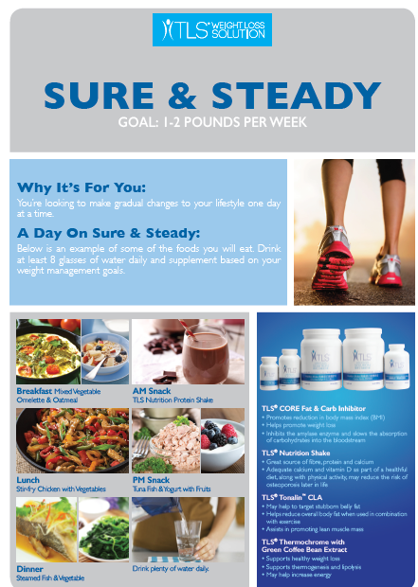
Sure & Steady
Why it’s for you:
Some people don’t dive right into the water; they ease their way in. The Sure & Steady plan helps those individuals looking to make gradual changes to their lifestyle, one day at a time. Throughout this 12-sddk program, you’ll see that even small changes to your diet, regular exercise, and support from TLS supplements can help achieve a healthier you.
What to expect:
Lose 1-2 pounds per week.
What you’ll do:
5-6 servings of proteins
6-12 servings of vegetables
2 servings of dairy
1 serving of starches
2 servings of good fats
1 serving of whole grains
2 servings of fruit
Exercise (3-5 days per week)
Take TLS Supplements, as directed.

Slide 33
Continued Commitment
Why it’s for you:
You’re at a healthy weight and are looking to maintain a healthy lifestyle. You want to focus on maintaining optimal body composition but are looking for a plan with flexibility, allowing the occasional indulgence.
What to expect:
Healthy, everyday living at your target weight.
What you’ll do:
Follow a balanced and healthy menu plan, with each day consisting of:
5-6 servings of proteins
6-8 servings of vegetables
2 servings of dairy
1 serving of starches
2 servings of good fats
2 servings of whole grains
2 servings of fruit
Exercise (4-5 days per week)
Continue use of TLS Supplements, as needed.

Slide 34
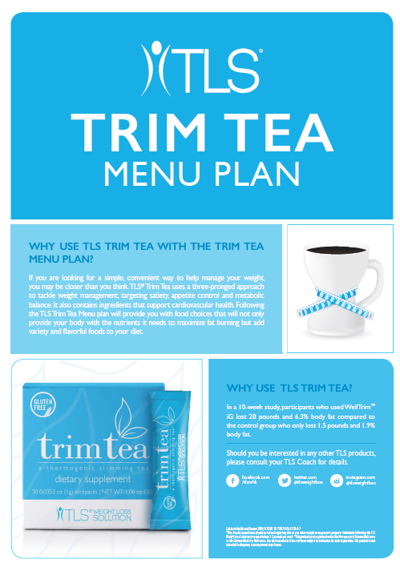
Trim Tea
Why it’s for you:
You’re committed to making some healthy changes while drinking one serving of TLS® Trim Tea daily.
What you’ll do:
Follow the Trim Tea low-glycemic menu plan, with each day
consisting of:
5 servings protein
6-8 servings of vegetables
2 fruits
2 servings of good fats
1 serving dairy
No grains
Exercise 3 days per week
Take TLS Trim Tea once daily

Slide 35
TLS® 21-Day Challenge... reveal a new you in just three weeks!
For those interested in fast results for 21 days
Phase 1 & 2
Kit helps you commit & has everything you need to succeed!
Notes:
Explain phase 1&2 and what is in kit for your market and

Slide 36
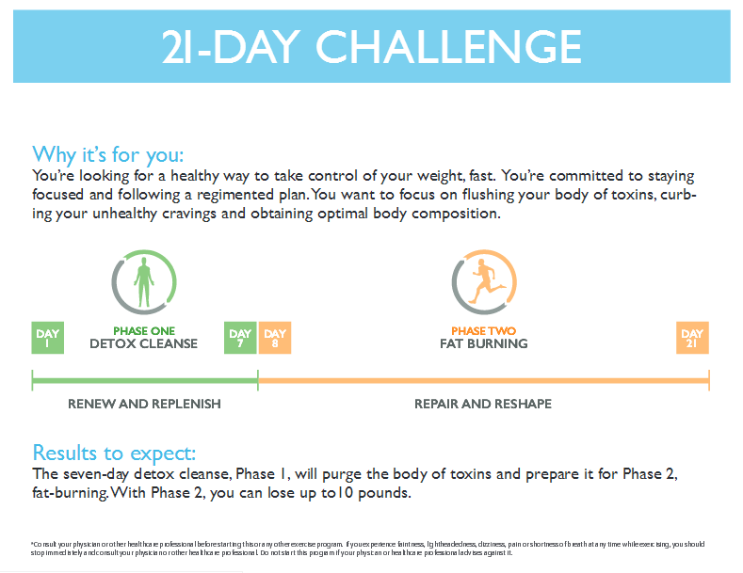

Slide 37
TLS is the... RIGHT PROGRAM
Backed by Science
Comprehensive
Customizable
Focus of Fat and Inches Lost
Teaches You How To Eat
Lifestyle Program

Slide 38
Are you ready...
Feel and look great?
Lose weight, body fat, & inches?
More energy?
Improve your health?

Slide 39
How do I get started...
Take the weight loss profile
Enroll into one of the programs your coach is offering
Select the products
Start today

Slide 40
TLS® Weight Loss Solution
OVERVIEW
TLS – Transitions Lifestyle System

